Slide 1
WELCOME TO
BASHA HIGH SCHOOL

Slide 2
Basha High School Graduation
Thursday, May 25th
Desert Financial Arena @ASU
7:30PM
Class of 2023

Slide 3
JUNIORS!
Your ACT score reports are here! Stop by your counselor’s office to pick up your copy before school, after school, or during lunch.

Slide 4
YEARBOOKS!
PICK UP YOUR PRE-ORDERED YEARBOOK IN F203
BEFORE SCHOOL AND DURING ALL 3 LUNCHES!

Slide 6
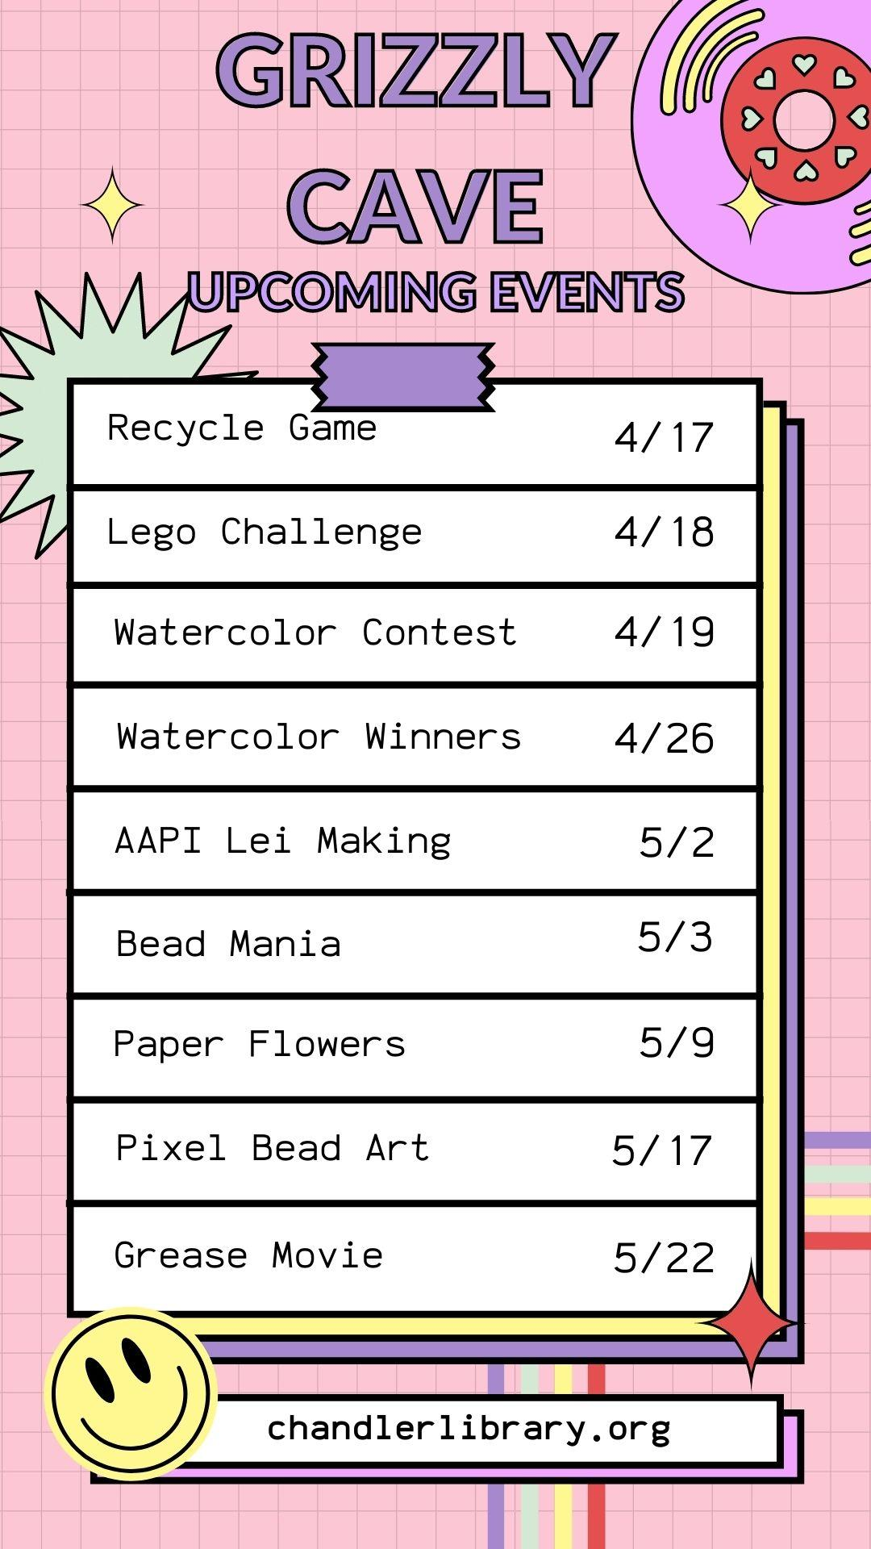

Slide 8
STUDENTS & STAFF!
Please DO NOT park at the library as those spaces are for library patrons.
STAFF, please park in the Staff lot North of the library.
STUDENTS, please park in the Student parking lot.
Thank you for being considerate to our public library friends.

Slide 9
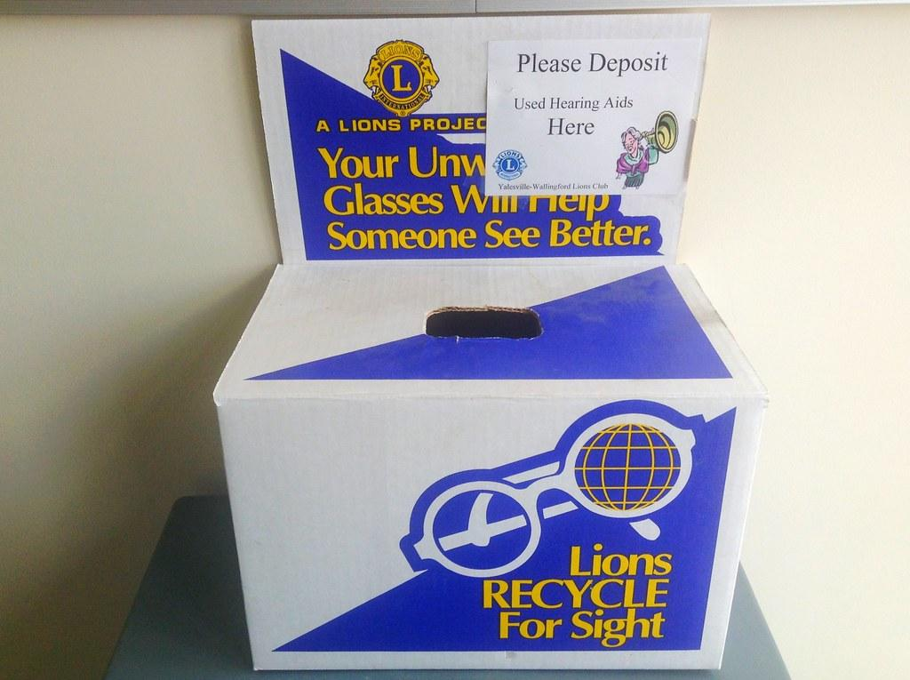
Your unwanted glasses will help someone see better!
DONATE today! The box is located in the Admin building @Kalli’s desk.

Slide 10
BASHA HIGH
does not accept food deliveries or food drop offs.
Thank you!

Slide 11
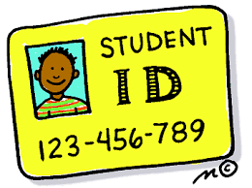
If you do not
have a
Basha High School ID, please go to the BOOKSTORE
to get one.
BOOKSTORE: F119
Everyone is required to have ID

Slide 12
AMS TUTORING AVAILABLE!
National Junior Honor Society members are willing to tutor AMS students. If interested see Mrs. Reed or email at reed.shannon@cusd80.com to get connected with a tutor!
Tutors available in:
English
Math
Science
Social Studies
Languages
General Help/Organization

Slide 13
Mindfulness Room
Relax with guided meditation in the
Mindfulness Room
on
Fridays
7:05AM-7:20AM

Slide 14
Free or Reduced Meals
Do you know if you’re eligible for free or reduced-priced school meals? Were you eligible last year? Applications must be submitted each school year. Visit myschoolapps.com to complete an application.

Slide 15
TUTORING AVAILABLE!
National Honor Society members are willing to tutor students in any grade and subject area! See your counselor or Chris Perry (perry.christopher@cusd80.com) to get connected with a tutor!
Tutors available in:
English
Math
Science
History/Geography
Languages
AP and Honors classes!

